Slide 1
BEEE ( Unit 4)
CONTENTS
1. Electrical machines: (Numericals are not expected) – principle of operation, constructional details, classification and applications of DC motors. https://www.youtube.com/watch?v=0vcDtiZUKqE
2. Three phase induction motor. https://www.youtube.com/watch?v=hv8rl8_JDug
3. Single phase induction motors. https://www.youtube.com/watch?v=A8IyYPACdsU
4. BLDC motor. https://www.youtube.com/watch?v=i1vc9X5rtqw https://www.youtube.com/watch?v=bCEiOnuODac
FE CSE-AIML Dr.Nirmala K

Slide 2
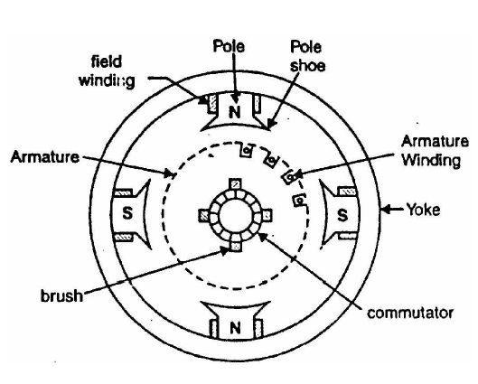
Construction of dc machine
DC motors are devices designed to convert direct current electrical energy to mechanical energy! This rotary electrical device has different types, all of them containing electromechanical internal mechanism responsible for changing the direction of current in the motor.
The parts of DC Motor are - a stator, a rotor, a yoke, poles, armature windings, field windings, commutator, and brushes. Many of its parts are the same as parts of AC motor, but with a little change.
1. Stator -A stator is one of the DC motor parts that is, as the name suggests, a static unit containing the field windings. The stator is the DC Motor part that receives the supply.
2. Rotor -The dynamic part of a DC motor is the rotor that creates the mechanical rotations of the unit.
3. Yoke-Another unit of the DC motor parts is the Yoke. A Yoke is a magnetic frame made of cast iron or sometimes steel, which works as a protector. This protective cover keeps the inner parts of the motor safe and sound and also supports the armature. Yoke also houses the magnetic poles and field windings of a DC motor to help supporting the field system.

Slide 3
4. Poles-DC motor has magnetic poles that fit into the inner wall of the Yoke with the help of screws to tighten them up. Poles have two parts: The Pole Core and the Pole Shoe. These two parts are fixed together by hydraulic pressure and are attached to the Yoke. Each part of the Poles has a specific task based on its design. The core holds the Pole Shoe over the Yoke while the Pole Shoe is structured to both carry slots for the field winding and spread the produced flux by the field windings into the air gap between the rotor and stator. It helps to reduce the loss caused by reluctance.
5. Field Windings-Made with Copper wire (field coils), the Field Windings circle around the slots carried by the Pole Shoes. The field windings form an electromagnet capable of producing field flux. The rotor armature rotates inside the field flux, resulting in the effective flux cutting.
6. Armature Windings-The armature winding of the DC motor has two constructions: Lap Winding and Wave Winding. Their difference is in the number of parallel paths. Armature Winding is attached to the rotor and alters the magnetic field in the path that it rotates. The result of this procedure is magnetic losses. Designers try to reduce the magnetic losses by making the armature core with some low-hysteresis silicon steel lamination.

Slide 4
7. DC Motor Commutator -The commutator is a split ring made up of Copper segments, Commutator is another DC motor part. The operating system of a DCs is based on the interaction of the two magnetic fields of rotating armature and a fixed stator. As the north pole of the armature is attracted to the south pole of the stator and south pole of armature is attracted to the north pole of the stator, a force is produced on the armature which makes it to turn. the process in which the field in the armature windings is switched to produce constant torque in one direction is called Commutation. the commutator is a device connected to the armature enabling this switching of current. Different segments of its cylindrical structure are insulated from each other by Mica. The commutator is designed to commute the supply current to the armature winding from the mains. The commutator passes through the brushes of the DC motor.
8. Brushes-The last part of the DC motor parts is Brushes that are made of Carbon or Graphite structures. Brushes with the commutator, are working as a bridge to connect the static electrical circuit to the rotor. Brushes are in contact with the commutator and relay the produced current to the commutator from an external circuit. The current then moves into the armature winding.

Slide 5
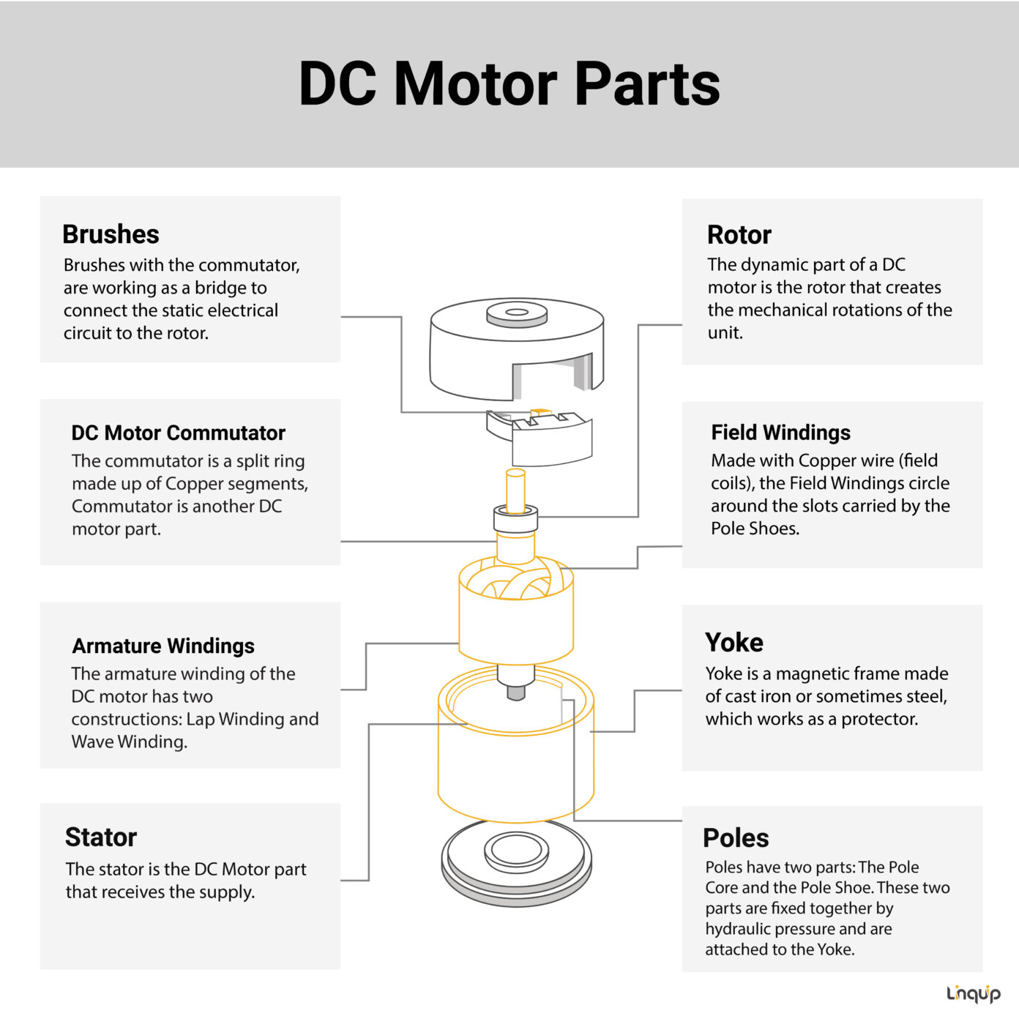

Slide 6
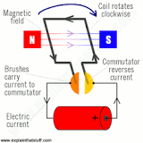
Operation-
DC motors take electrical power through direct
current, and convert this energy into mechanical
rotation. It works on the principle of Lorentz Law,
which states that “the current carrying conductor
placed in a magnetic and electric field experience
a force”. And that force is the Lorentz force.
They operate using principles of electromagnetism,
which shows that a force is applied when an
electric current is present in a magnetic field. This
force creates a torque on a loop of wire present in the
magnetic field, which causes the motor to spin and
perform useful work.

Slide 7
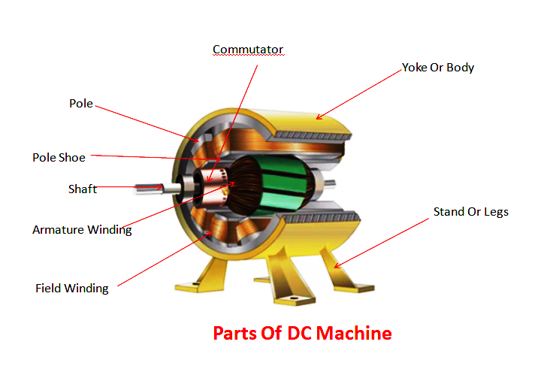

Slide 8
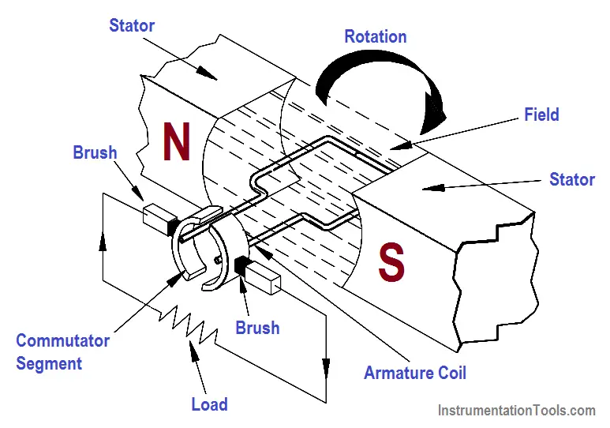

Slide 9
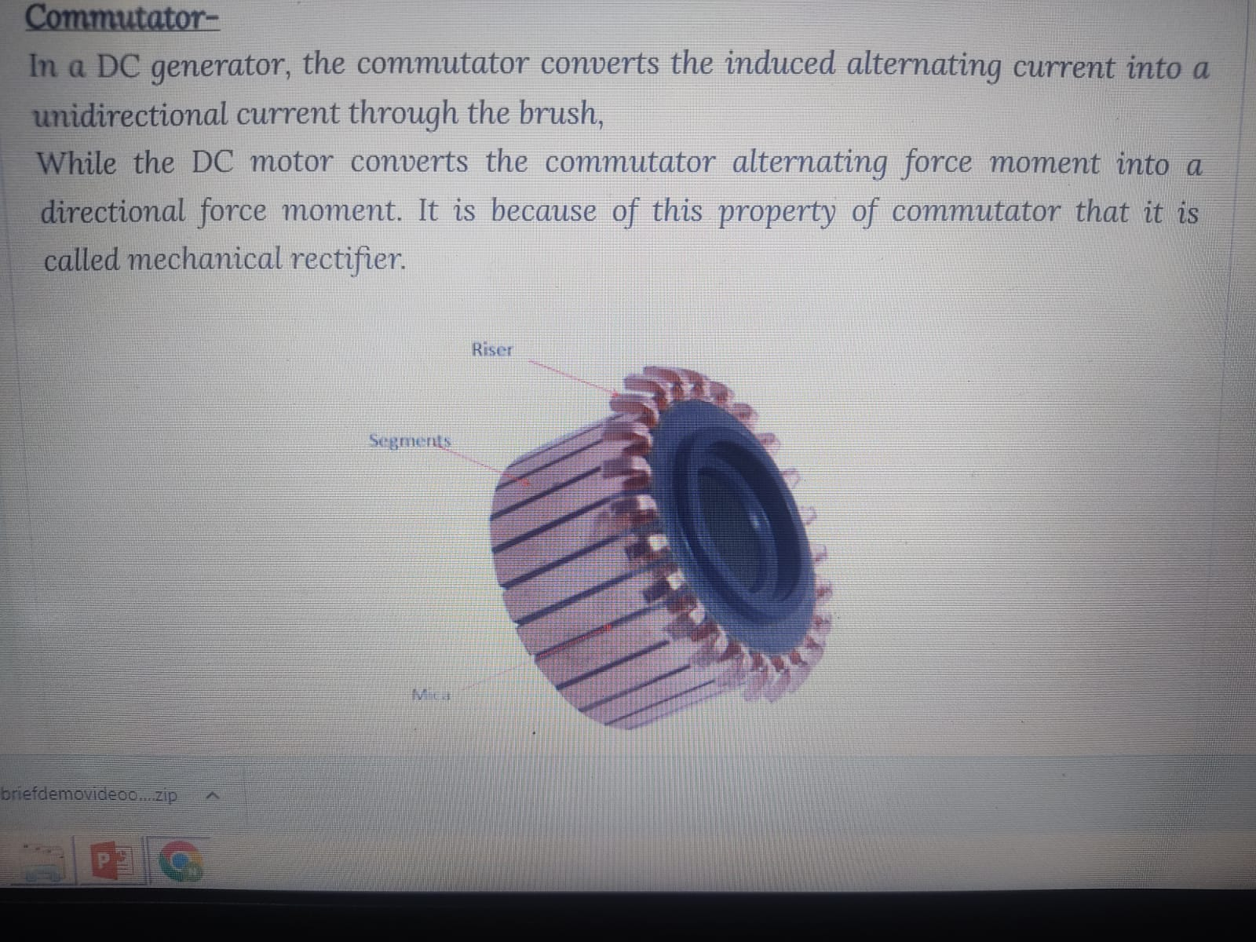
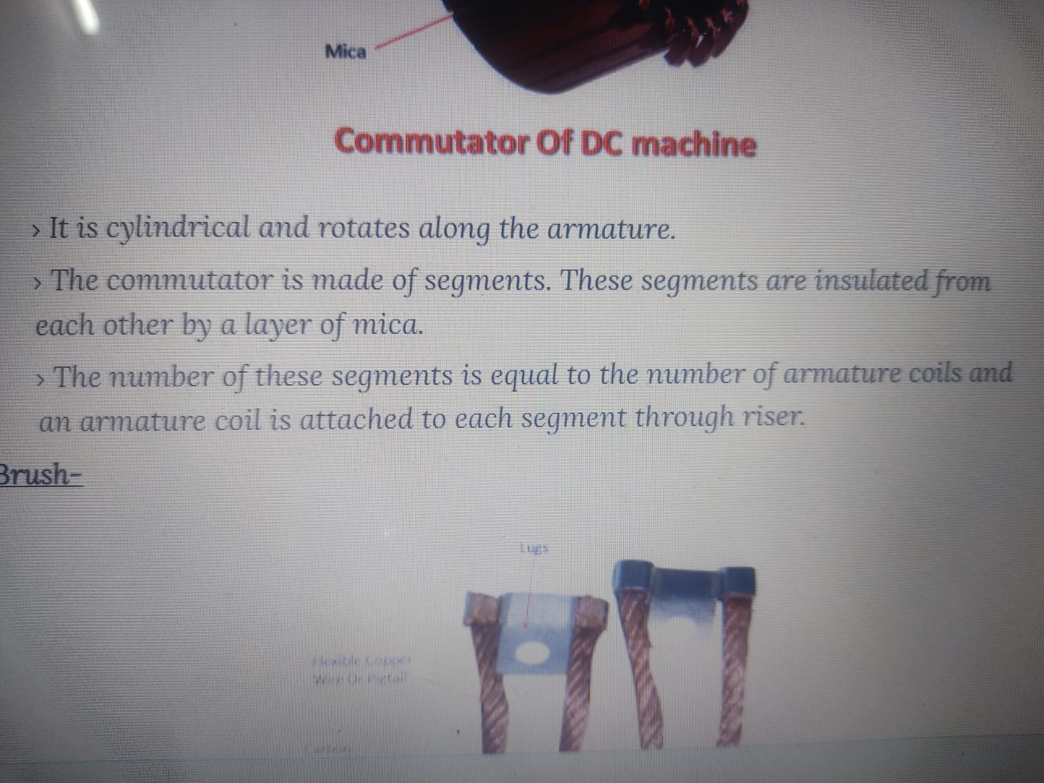
Commutator-

Slide 10
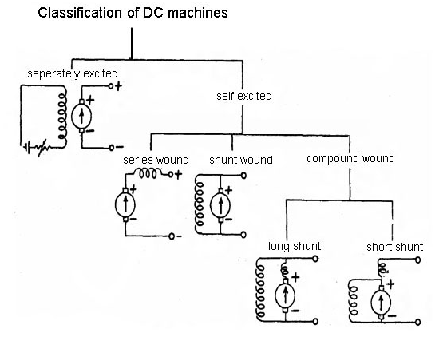
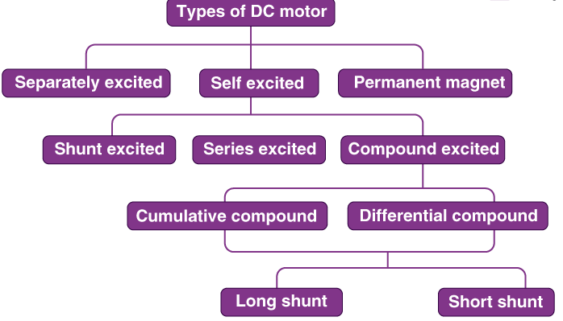
Classification and applications of DC motors.

Slide 11
1.Permanent Magnet DC Motor-In these types of DC motor, the permanent magnet is used to create a magnetic field. In this, no input current is consumed for excitation. These are used in automobile starters, wipers, air conditioners, etc
2. Shunt DC Motor -Here, the field is connected with the armature windings in parallel or also known as a shunt. The shunt field can be separately excited from the armature windings and that is the reason it can be used for greater speed regulation and can also offer very simplified reverse control.
3. Series DC Motor-Here, a large wire carrying the full armature current winds the field with few turns. This kind of motor generates a large amount of starting torque but the speed cannot be regulated here. If they are run with no load then it might face damage. These are not the ideal option for variable speed applications.
4. Compound DC Motor -These have a shunt field which is separately excited. They have a good starting torque but might face problems in variable speed applications.
5. Short Shunt DC Motor -Here, the shunt field winding is only connected with the armature winding and that too in parallel. The field coil, which is in series, is entirely exposed to current before being split up into the armature.
6. Long Shunt DC Motor -Here, the shunt field winding is connected in parallel with the both series field coil and armature which are again connected with each other in series.
7. Differentially Compound DC Motor -In this type of compound wound DC motor, the flux produced due to the shunt field windings reduces the effect of the main series windings.
8. Cumulative Compound DC Motor- Here, the flux produced by the shunt field windings enhances the effect of the main field flux which is produced by series winding.

Slide 12
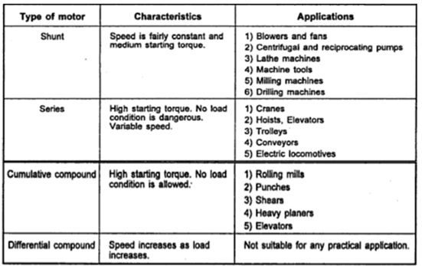

Slide 13
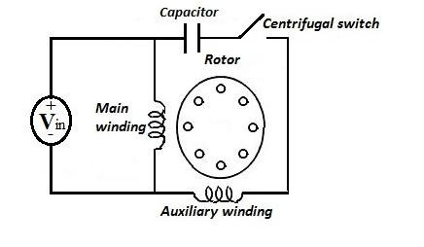
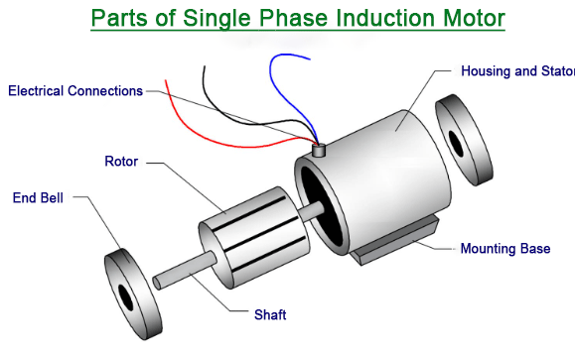
Single phase induction motors-
Construction-Constructionally, single phase induction motor is similar to polyphase induction motor except that (i) its stator is provided with a single phase winding and (ii) a centrifugal switch in order to cut out a winding used for starting purposes. It has distributed stator winding and a squirrel cage rotor.
Operation-Single-phase induction motors main winding is supplied with a single -phase A.C. current. This produces fluctuating magnetic flux around the rotor. This means as the direction of the A.C. current changes, the direction of the generated magnetic field changes.
https://www.youtube.com/shorts/s18m-rmr-IE
WORKING
https://www.youtube.com/shorts/y96yuF703Ns
3 PHASE MOTOR WITH STAR DELTA CONNECTION

Slide 14
Types of single phase induction motors-
1). Split phase motors.
Resistance-start motors.
Capacitance-start motors.
Permanent split capacitor motor.
d. Two-value capacitor motor.
2). Shaded-pole induction motors.
3). Reluctance-start induction motor.
4). Repulsion –start induction motor.
Applications of Single Phase Induction Motor
These motors find use in fans, refrigerators, Air-conditioners, Vacuum cleaners, washing
machines, centrifugal pumps, tools, small farming appliances, blowers etc….These are mostly
used for low power but constant speed devices such as agricultural tools and machinery where
three -phase supply are not available. 1/400 kW to 1/25 kW motors are used in toys, hair dryers,
etc…

Slide 15
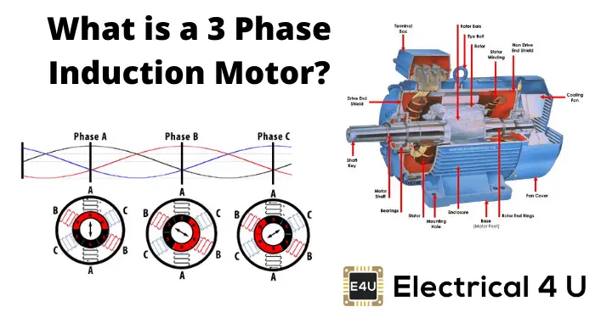
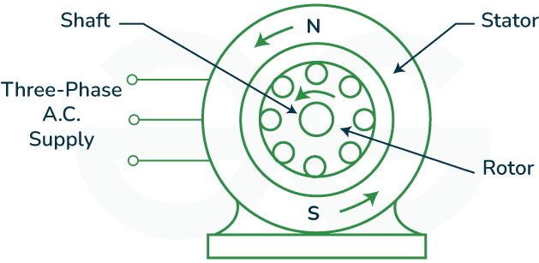
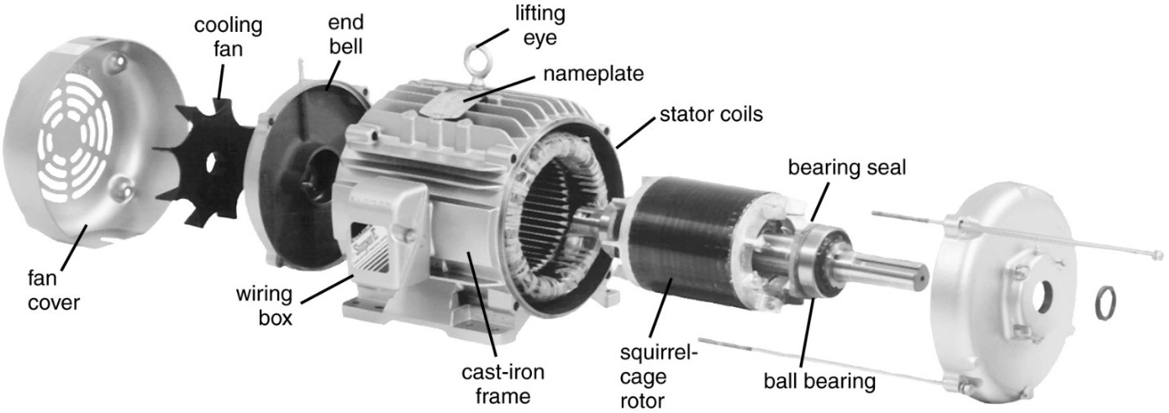
Three phase induction motor

Slide 16
Construction and working- https://www.youtube.com/watch?v=59HBoIXzX_c
A 3-phase induction motor is a device that does electromechanical energy conversion. It converts three-phase electrical power input into mechanical power output. Three-phase induction motor is the most widely used motor in the case of three phase Alternating current operation, as this type of motor does not require an additional starting device. This is why it is also called a self-starting induction motor. A 3-phase induction motor has two main parts which are a stator and a rotor. 3-phase stator winding is carried by the stator while the rotor carries a short-circuited winding or rotor winding. A 3-phase supply is fed to stator winding. The rotor winding takes its power and voltage from the stator winding through electromagnetic induction.
A three phase induction motor is an AC-type induction motor that operates on three-phase supply like a single-phase induction motor where a single-phase supply is needed to operate it. An electromagnetic field is produced by three three-phase supply currents in the stator winding which which will produce the torque in the rotor winding of the three phase induction motor in the presence of the magnetic field.
https://www.youtube.com/watch?v=rPtqmIAe93Y -ANIMATED

Slide 17
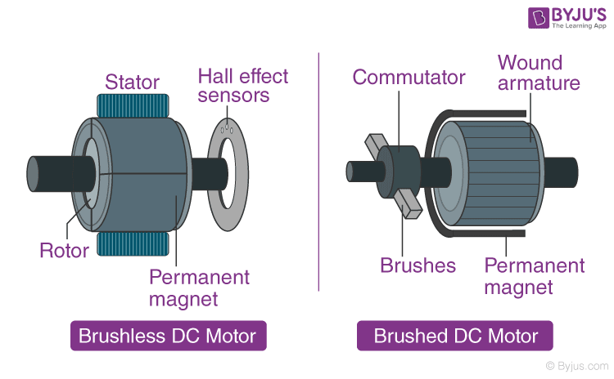
BLDC
A Brushless DC/ BLDC motor is a type that is most suitable for applications that require high reliability, high efficiency, more torque per weight, etc. A commutator-brushes arrangement helps in achieving unidirectional torque in a dc motor. But commutator and brush arrangement is eliminated in a brushless dc motor. Here, an integrated inverter/switching circuit is used to achieve unidirectional torque. That is why these motors are, sometimes, also referred as 'electronically commutated motors'.
Just like any other electric motor, a BLDC motor also consists of two main parts a stator and a rotor. Permanent magnets are mounted on the rotor of a BLDC motor, and the stator is wound for a specific number of poles. Also, a control circuit is connected to the stator winding. Most of the times, the inverter/control circuit or controller is integrated into the stator assembly. This is the basic constructional difference between a brushless motor and a typical dc motor.
Operation-Stator windings of a BLDC motor are connected to a control circuit (an integrated switching circuit or inverter circuit). The control circuit energizes proper winding at the proper time, in a pattern which rotates around the stator. Permanent magnets on the rotor try to align with the energized electromagnets of the stator, and as soon as it aligns, the next electromagnets are energized. Thus, the rotor keeps running.

Slide 18
Applications Of BLDC Motors
BLDC motors fulfill many requirements that a brushed DC motor does. But as they require a complicated control circuit and due to cost considerations, they haven’t yet completely replaced brushed DC motors, especially in low-cost applications. Despite this, there are many applications where BLDC motors dominate –
Consumer electronics – computer hard drives, small cooling fans, cd/dvd players, etc. and also in modern appliances where quiet operation is desired – such as washing machines, air conditioners, etc.
Electric Vehicles – many electric vehicles including electric and hybrid cars, electric bikes use BLDC motors.
They have a wide range of applications in many other areas including robotics, industrial, motion control systems, etc.

Slide 19
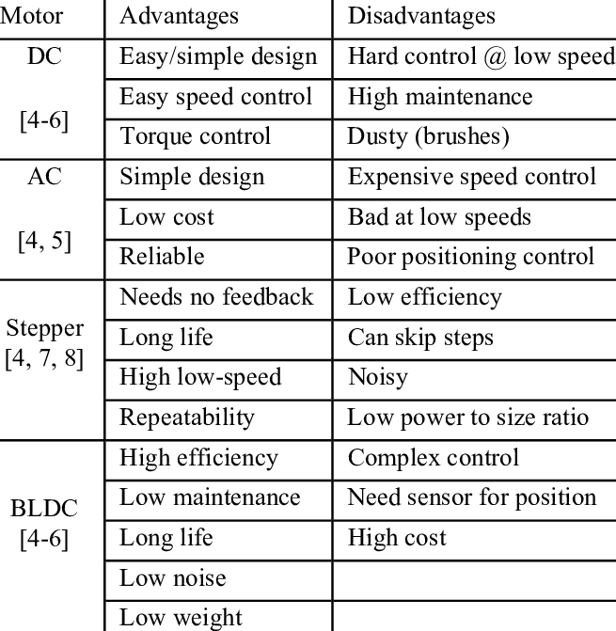

Slide 20
Practice questions
Unit 4- Electrical Machines
With neat sketch explain the working principle of DC motor.
Explain the functions of different parts of DC motors with neat sketch.
Give the function of commutator in a DC motor.
Classify different types of DC motors with neat sketch.
Derive for the EMF equation of Dc motor.
List the applications of DC motor.
Explain the principle of operation along with constructional details ,three phase induction motor. List its applications.
Explain the principle of operation along with constructional details, single- phase Induction motors . List its applications.
Explain the principle of operation along with constructional details of Brushless DC motor (BLDC).List 4 advantages and 2 disadvantages.
Compare single/three phase induction motor, DC motor and BLDC (6 points).
(4 questions given for assignment + above highlighted- merge the above common with them)
                Course teacher
                Dr. Nirmala Kamble

